Slide 1
Nutrients
Chapter 3

Slide 2
Lesson Objectives
Explain why carbon is essential to life on Earth.
Describe the structure and function of carbohydrates.
Describe the structure and function of lipids.
Describe the structure and function of proteins.
Describe the structure and function of nucleic acids.

Slide 3
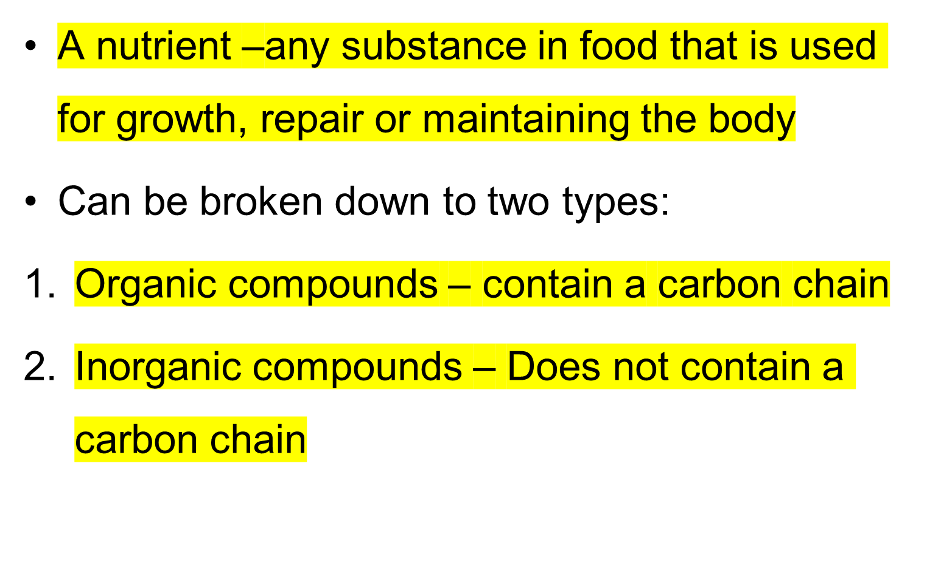
Introduction

Slide 4
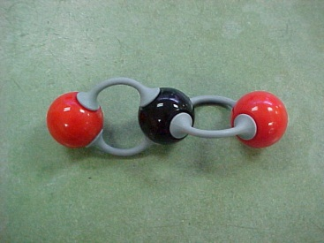
THE SIGNIFICANCE OF CARBON
Nearly 10 million carbon-containing organic compounds are known
Types of carbon compounds in organisms include carbohydrates, lipids, proteins, and nucleic acids
Carbon can bond with a wide variety of other elements forming a variety of very large and complex molecules
  including hydrogen, oxygen, and nitrogen
Carbon can also bond to other carbons
  may form single, double, or even triple bonds
Notes:
Handout Charts to fill in…..

Slide 5

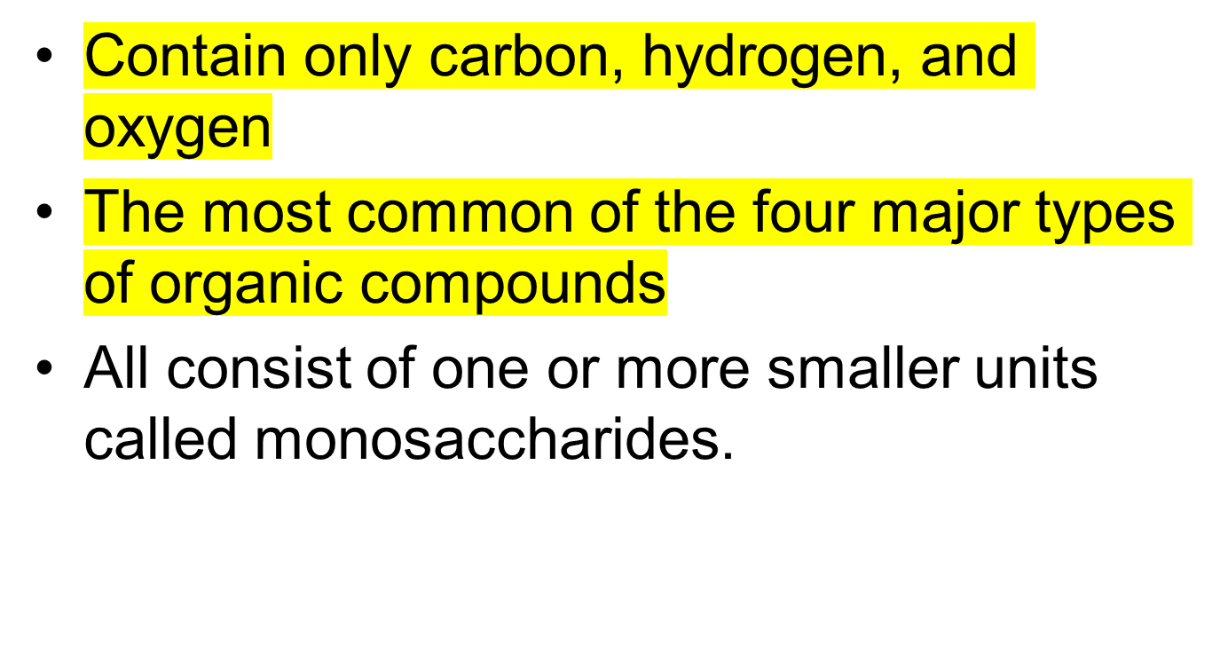
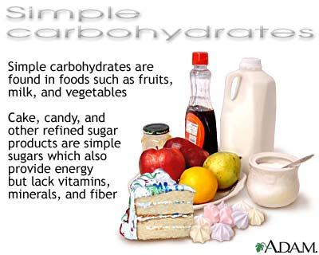
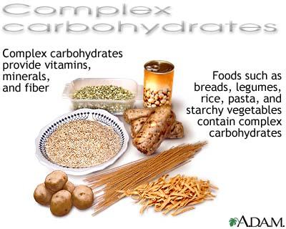

Slide 6
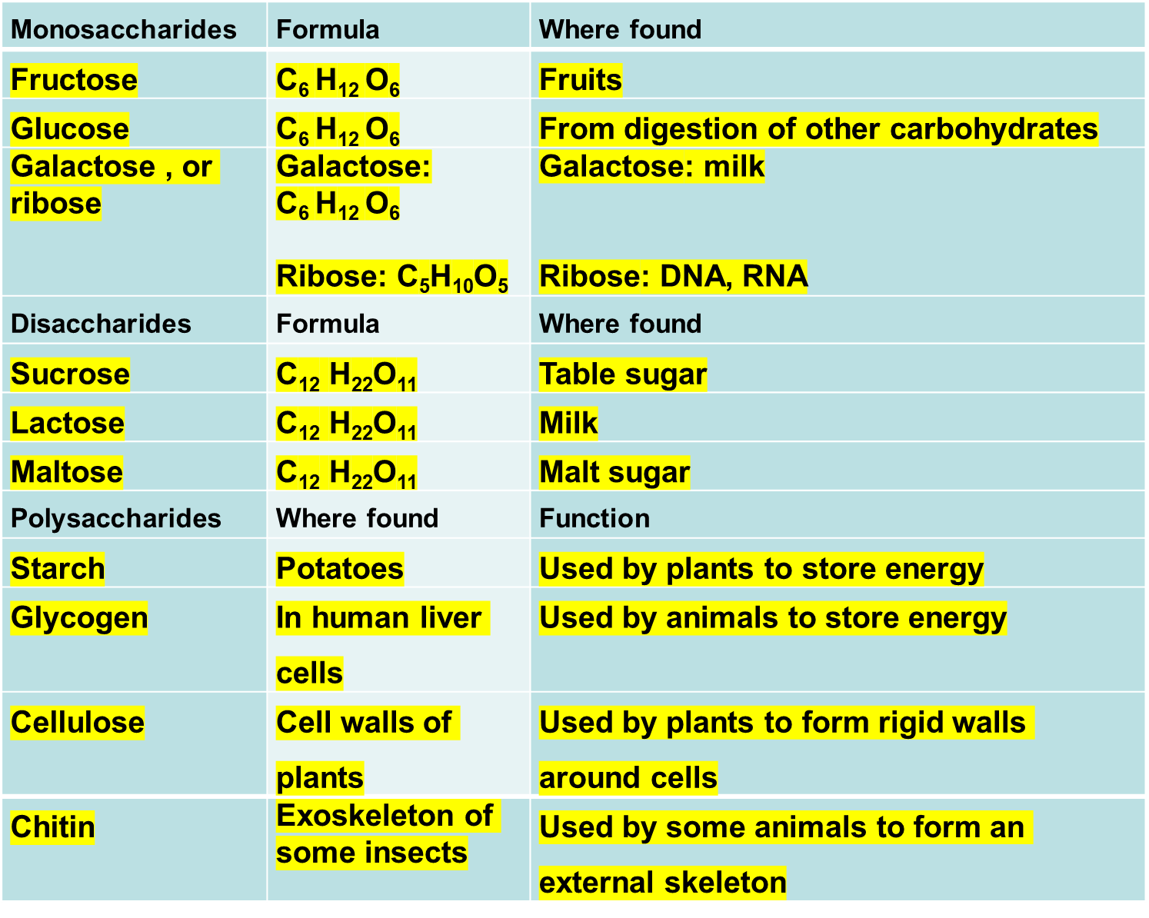

Slide 7

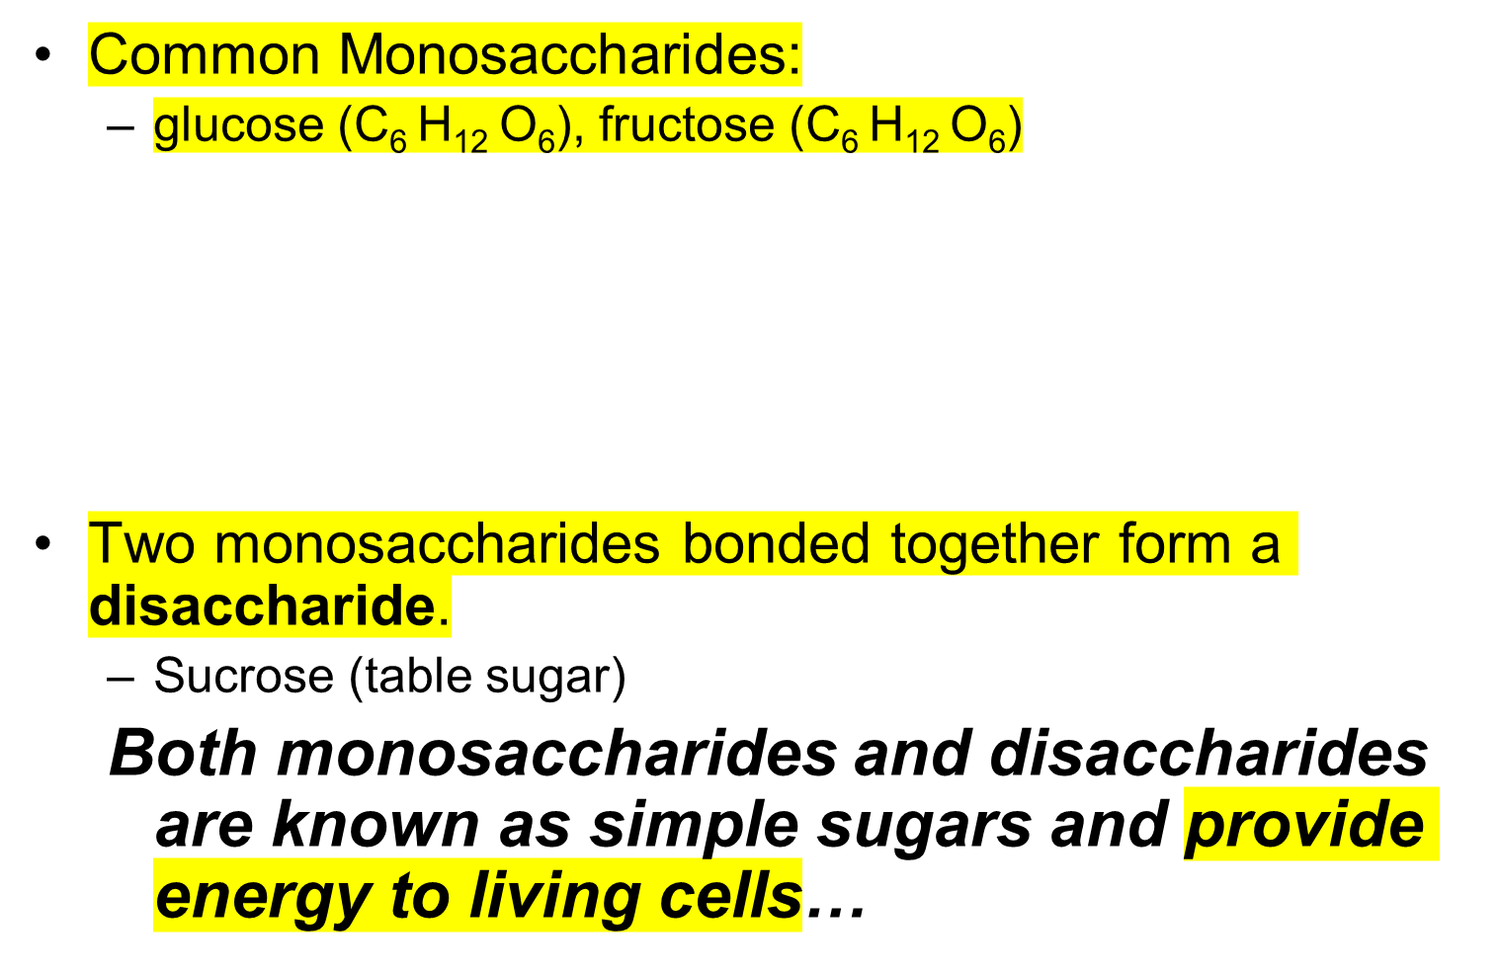
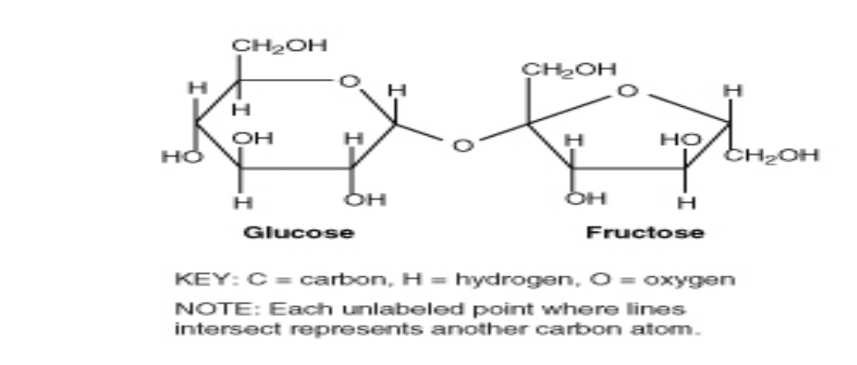
Notes:
Another monosaccharide, fructose, has the same chemical formula as glucose, but the atoms are arranged differently. Molecules with the same chemical formula but with atoms in a different arrangement are called isomers.
Compare the glucose and fructose molecules can you identify their differences?.... The only differences are the positions of some of the atoms. These differences affect the properties of the two monosaccharides.

Slide 8
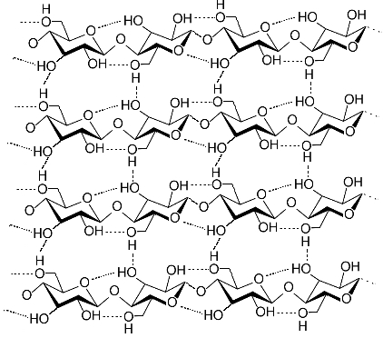
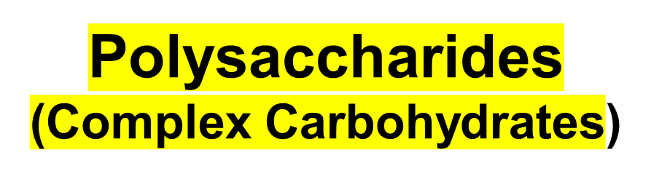
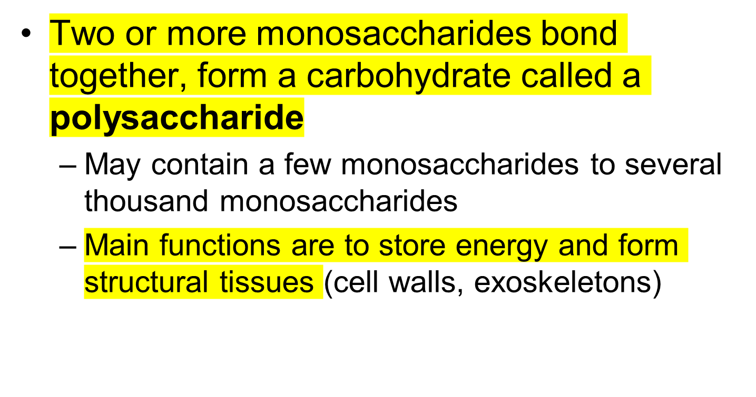
Notes:
Table 1.2: Complex Carbohydrates
____________________________________________________________________________
Complex Carbohydrate Function Organism
____________________________________________________________________________
Amylose Stores energy Plants
Glycogen Stores energy Animals
Cellulose Forms cell walls Plants
Chitin Forms external skeleton Some animals
These complex carbohydrates play important roles in living organisms.

Slide 9
The Compounds of Life
 | Composition (elements present) | Function | Examples | Monomer
Carbohy-drates | Carbon, Hydrogen, and Oxygen C,H,O | Provide energy to living cells; form structural tissue | Glucose Fructose Sucrose | Mono-saccharides
Lipids
Proteins
Nucleic acids

Slide 10
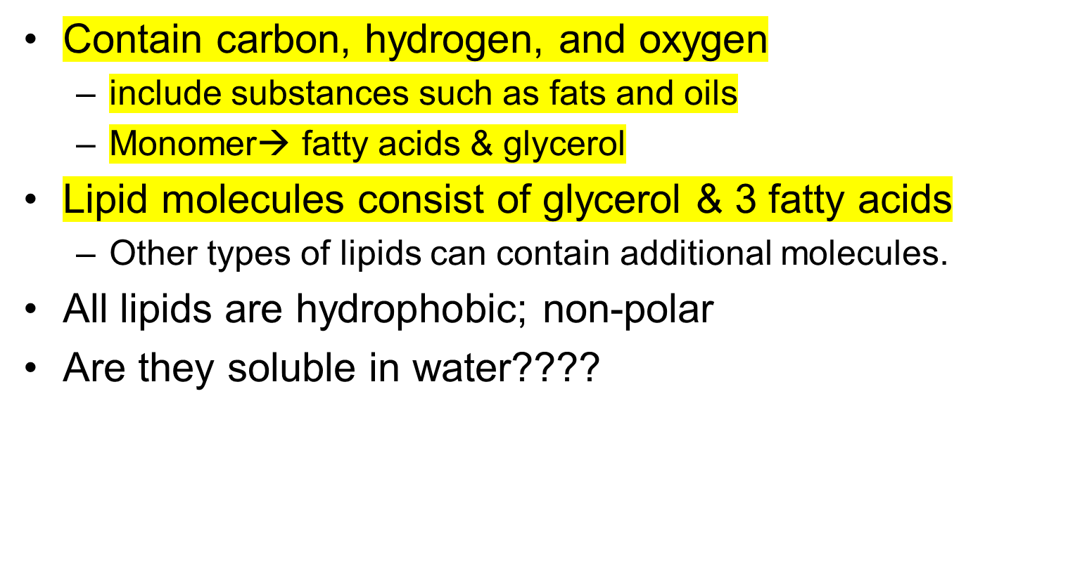
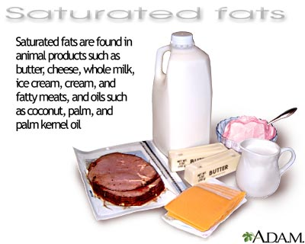
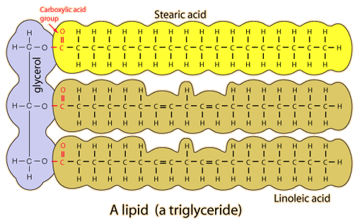
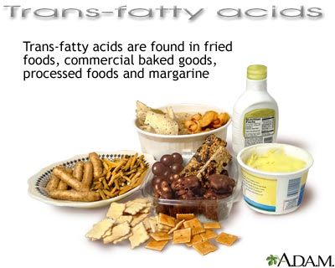
LIPIDS
NO
Notes:
FUNCTION: stores energy, forms cell membranes, carries messages…

Slide 11
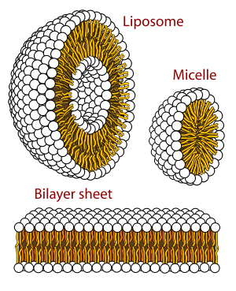
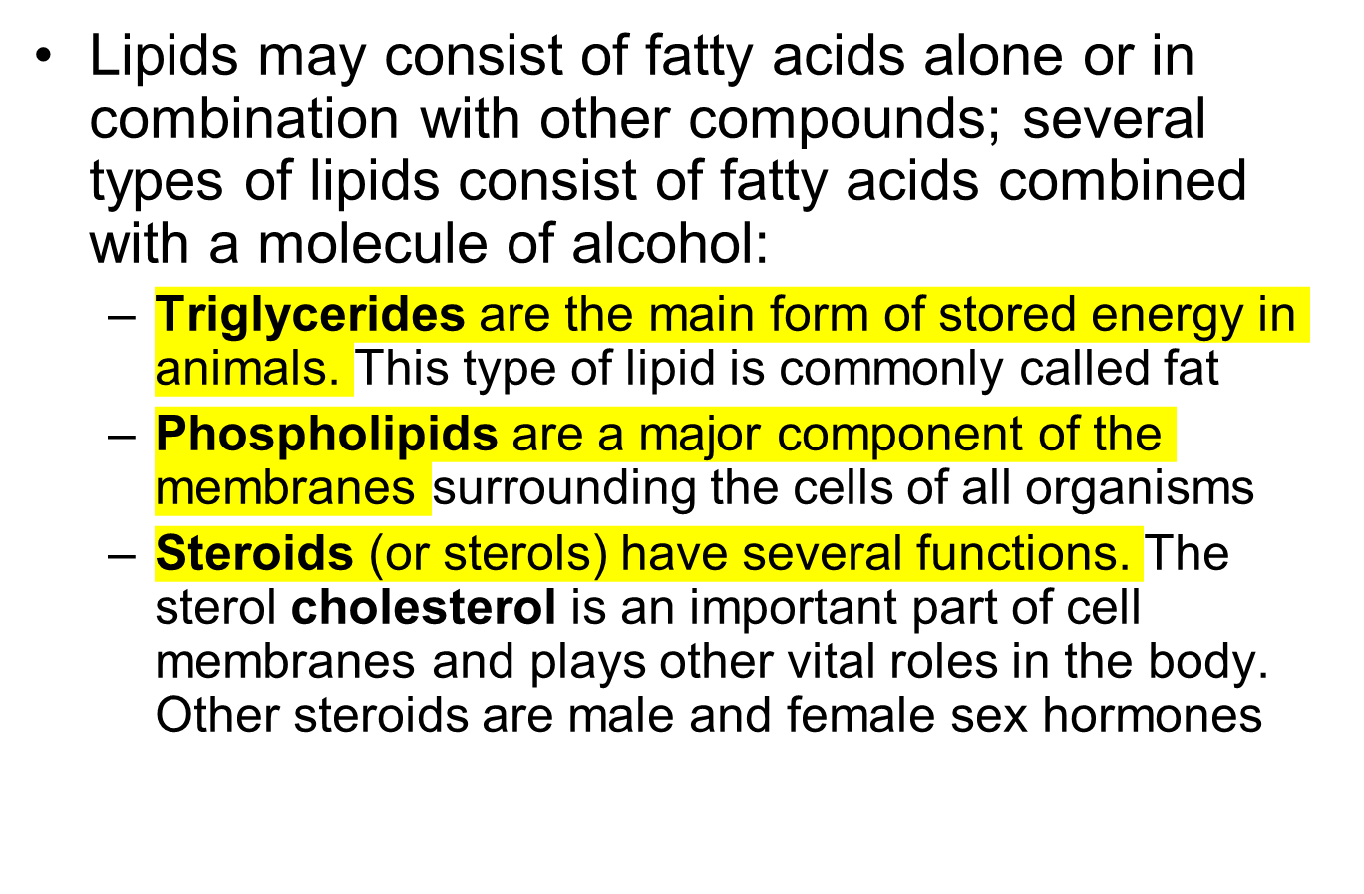
Types of Lipids
Notes:
Bilayer sheet= phospholipids bilayer
Hydrophobic tails
Hydrophilic heads

Slide 12
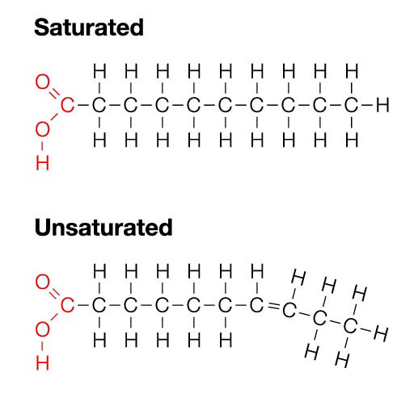
Saturated Fatty Acids
Saturated fatty acids are solids at room temperature
Saturated refers to the placement of hydrogen atoms around the carbon atoms
Saturated fatty acid, have a COOH group; all the C atoms (other than the C in the -COOH group) are bonded to two or more H atoms with single bonds
  they form straight chains
Structure allows saturated fatty acids to be packed together tightly; dense storage of chemical energy
  fatty tissues of animals contain mainly saturated fatty acids

Slide 13
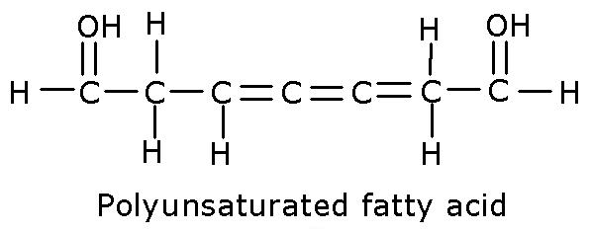
Unsaturated Fatty Acids
Unsaturated fatty acids are liquids at room temperature
Unsaturated fatty acid, also have a COOH group; some carbon atoms are not bonded to as many hydrogen atoms as possible because they are bonded to one or more additional groups, including double and triple bonds between carbons
  they cause the chain to bend - do not form straight chains
Unsaturated fatty acids are found mainly in plants, especially in fatty tissues such as nuts and seeds.
-- monounsaturated
Notes:
One double carbon bond means monounsaturated fatty acid
Two or more double bonds means polyunsaturated fatty acid

Slide 14
Type of Lipid | Characteristics | Where found
Triglycerides | Main form of stored energy in animals | vegetable oil (typically more unsaturated) animal fats (typically more saturated)
Saturated | Form straight chains b/c carbon atoms are bonded to as many H atoms as possible; store energy in compact form; solid at room temperature | Animals use these to store energy
Unsaturated | Form bent chains b/c some C atoms are not bonded to as many H atoms as possible; store energy; liquid at room temperature | Plants use these to store energy
Phospholipids | Major component of cell membranes | Liver, peanuts
Steroids | Serve as chemical messengers and have other roles | found in plants, animals, and fungi

Slide 15

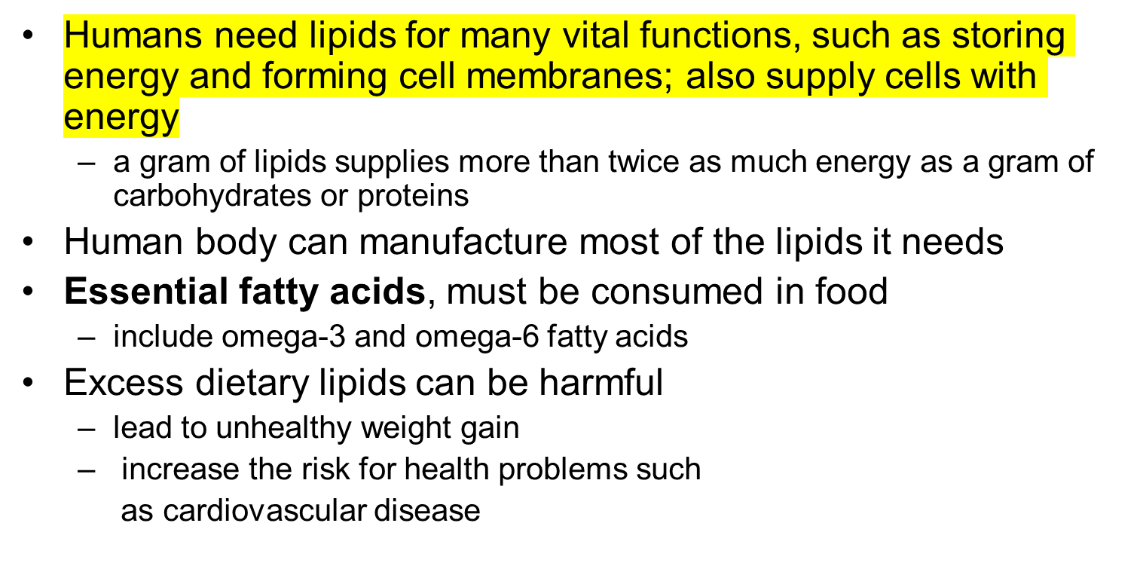
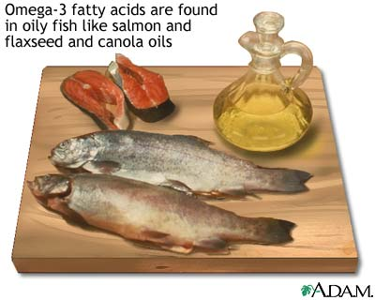
Notes:
Omega- 3 in (Coldwater fish like tuna, salmon, lake trout, mackerel, shrimp are rich sources of omega3. Plant sources include flaxseed oil and pumpkin seed oil. Omega 3 fatty acids are highly concentrated in the brain and appear to be particularly important for cognitive and behavioral function. In fact, infants who do not get enough omega 3 fatty acids from their mothers during pregnancy are at risk for developing vision and nerve problems. Omega-3 fatty acids are good for heart. They reduce triglyceride levels, raise levels of HDL (”good”) cholesterol, and manage blood pressure.); Omega- 6 in (Omega-6 fatty acids are beneficial as well. They help regulate inflammation and blood pressure as well as heart, gastrointestinal, and kidney functions. Good dietary sources of omega-6 fatty acids include cereals, eggs, poultry, most vegetable oils, whole-grain breads, baked goods, and margarine.)
The dietary lipids of most concern are saturated fatty acids, trans fats, and cholesterol. For example, cholesterol is the lipid mainly responsible for narrowing arteries and causing the disease atherosclerosis.

Slide 16
The Compounds of Life
 | Composition (elements present) | Function | Examples | Monomer
Carbohy-drates- | Carbon, Hydrogen, and Oxygen C,H,O | Provide energy to living cells; form structural tissue | Glucose Fructose Sucrose Glycogen Cellulose | Mono-saccharides
Lipids | Carbon, hydrogen, and Oxygen C,H,O | Hydrophobic --form cell membranes Store energy | Fats, Oils, Waxes, Steroids | Glycerol & 3 Fatty Acids (for fats & oils)
Proteins
Nucleic acids

Slide 17

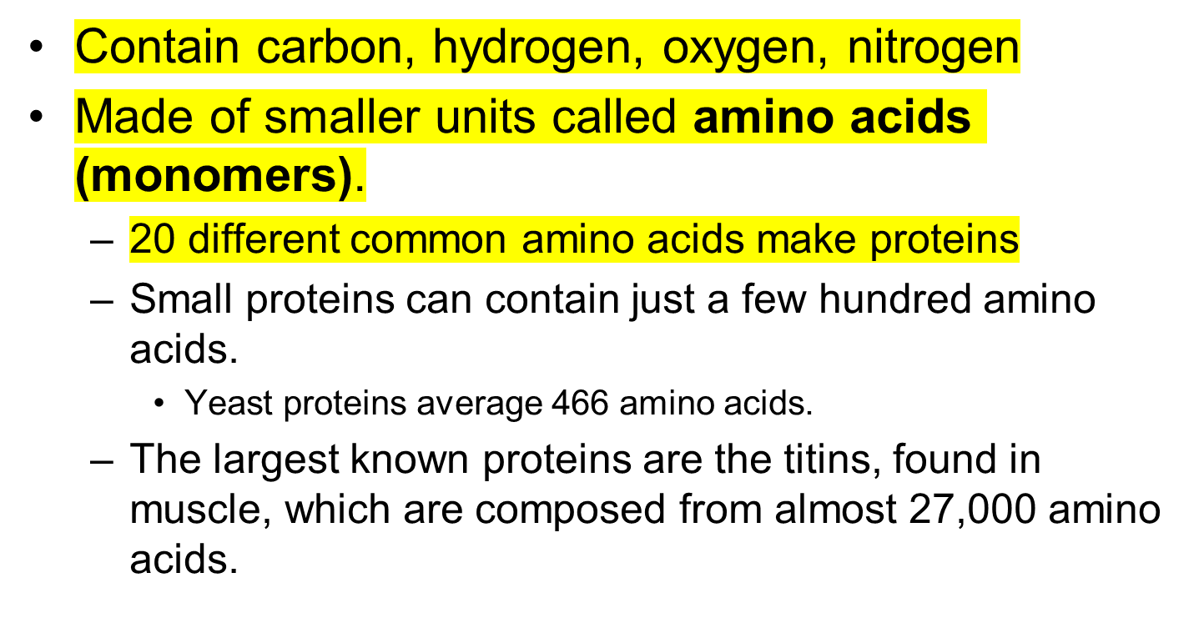
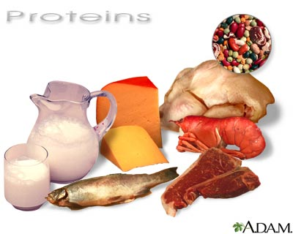

Slide 18

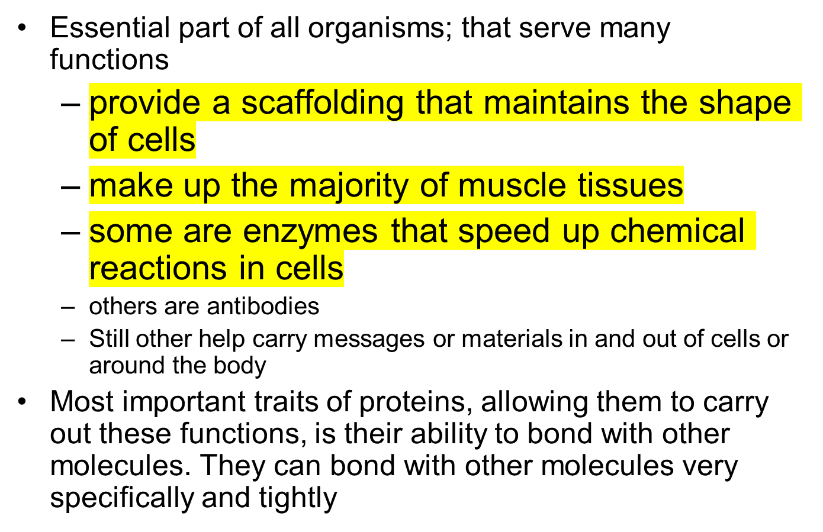

Slide 19

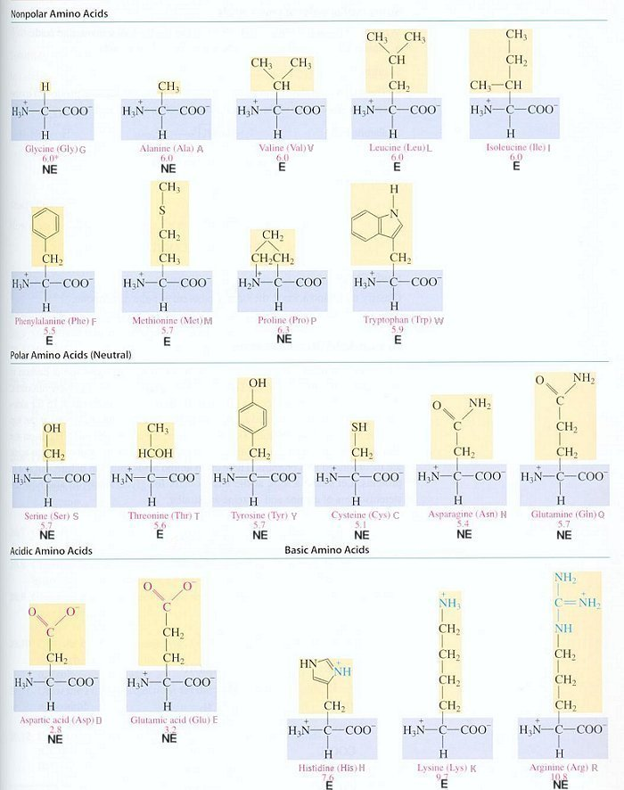
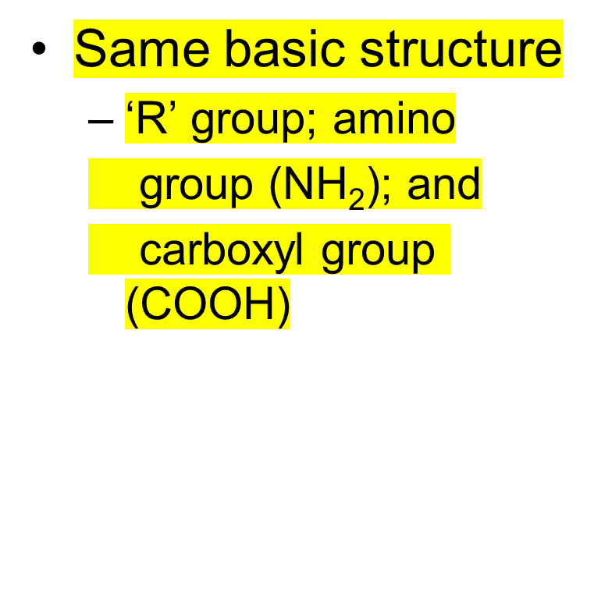
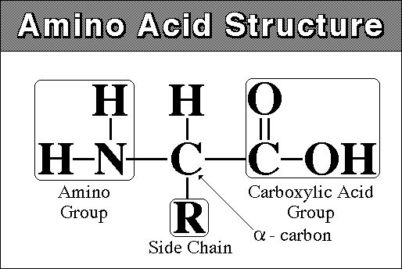
Notes:
Amino acids are molecules containing an amino group (shown here as H₂N), a carboxylic acid group and a side chain “R” group that varies between different amino acids

Slide 20
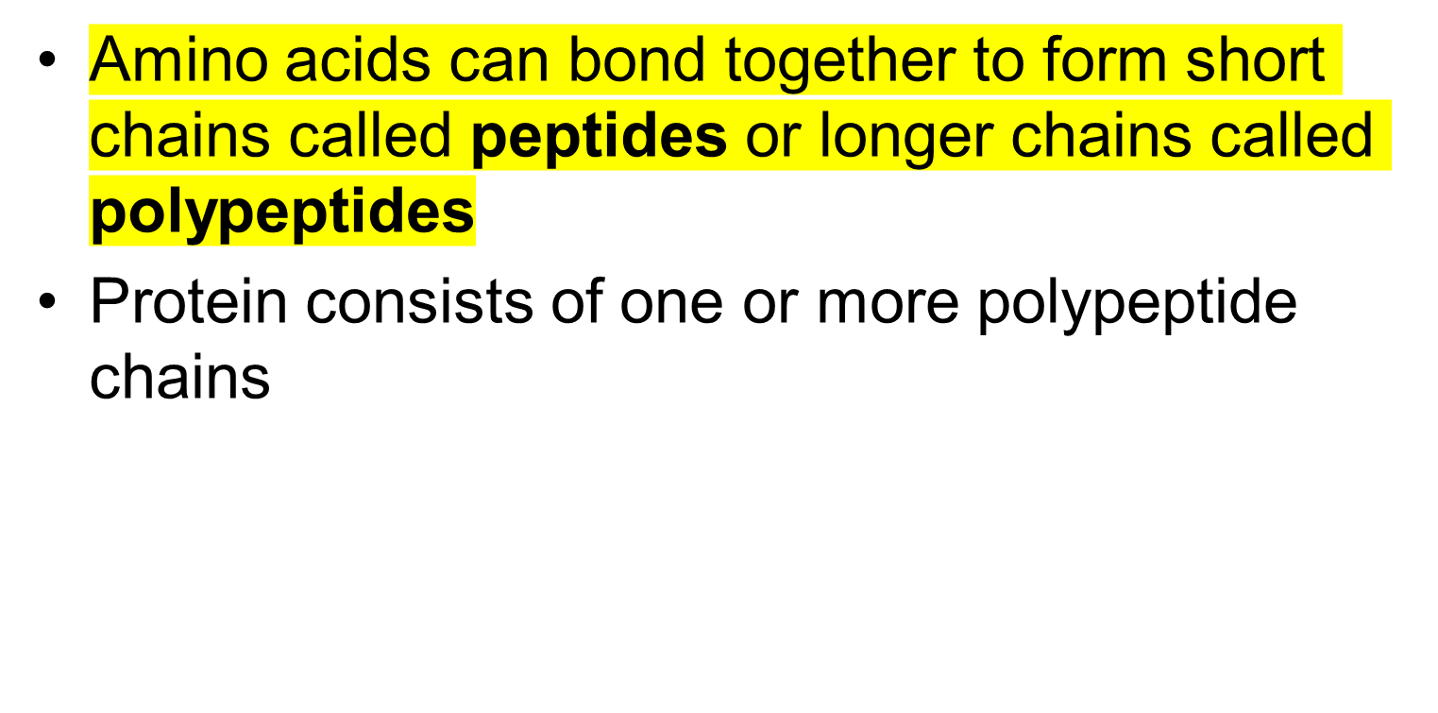
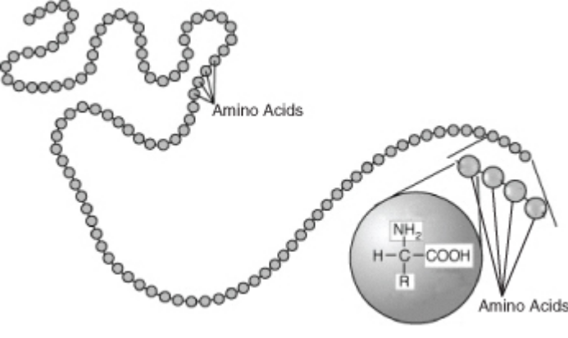
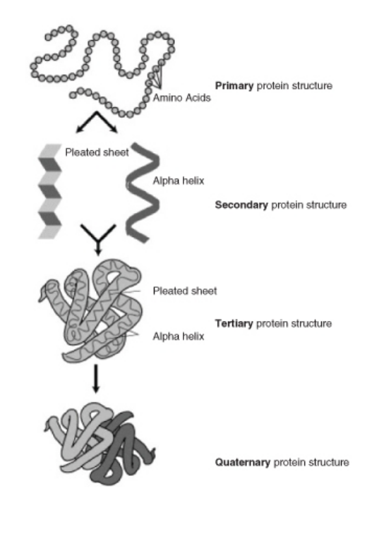
Protein Structure
http://www.stolaf.edu/people/giannini/flashanimat/proteins/protein%20structure.swf
Notes:
Polypeptides may have as few as 40 amino acids or as many as several thousand.
The order of amino acids, together with the properties of the amino acids, determines the shape of the protein, and the shape of the protein determines the function of the protein. KEY: H = hydrogen, N = nitrogen, C = carbon, O = oxygen, R = variable side chain.
Figure on left: Polypeptide. This polypeptide is a chain made up of many linked amino acids. The amino acid sequence is the primary structure of a protein.
Figure on right: a protein may have up to four levels of structure, from primary to quaternary. The complex structure of a protein allows it to carry out its biological functions.

Slide 21

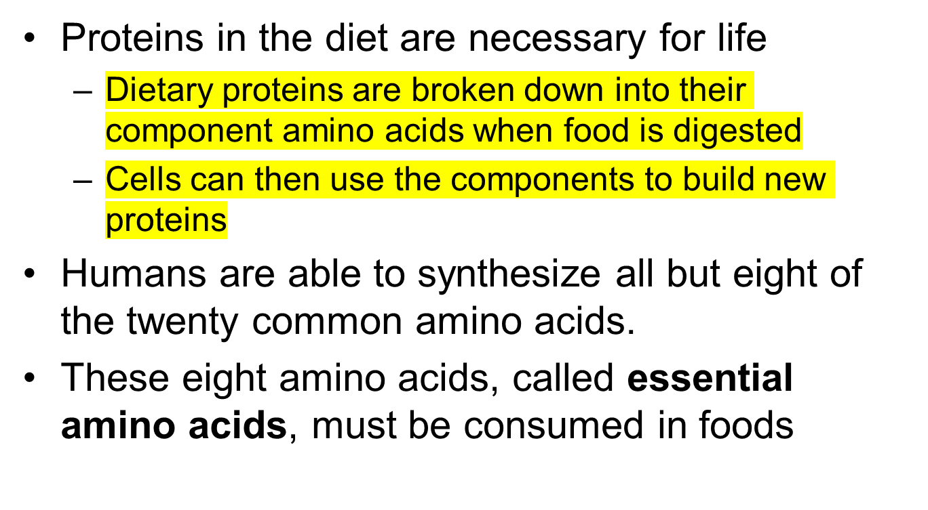
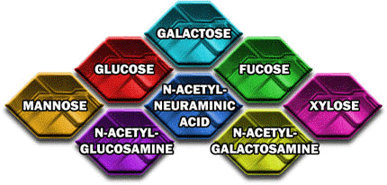

Slide 22
Protein Denaturation
http://www.youtube.com/watch?v=3IL_Df5ouUc
Definition: the change in the shape of protein molecules_without _denaturation we could not eat many delicious foods; _is _necessary for survival so we can break down proteins we eat into components our bodies can use; _changes or halts _the shape of the protein molecule/cellular function.
Is caused by _extreme conditions—heat, acid (change of pH), or force____40◦C________

Slide 23
The Compounds of Life
 | Composition (elements present) | Function | Examples | Monomer
Proteins | Carbon, Hydrogen, Oxygen, and Nitrogen C,H,O,N | Maintain cell shape; Make muscle tissue; Speed up chemical reactions; Carry messages | Enzymes Antibodies | Amino Acid
Nucleic acids

Slide 24

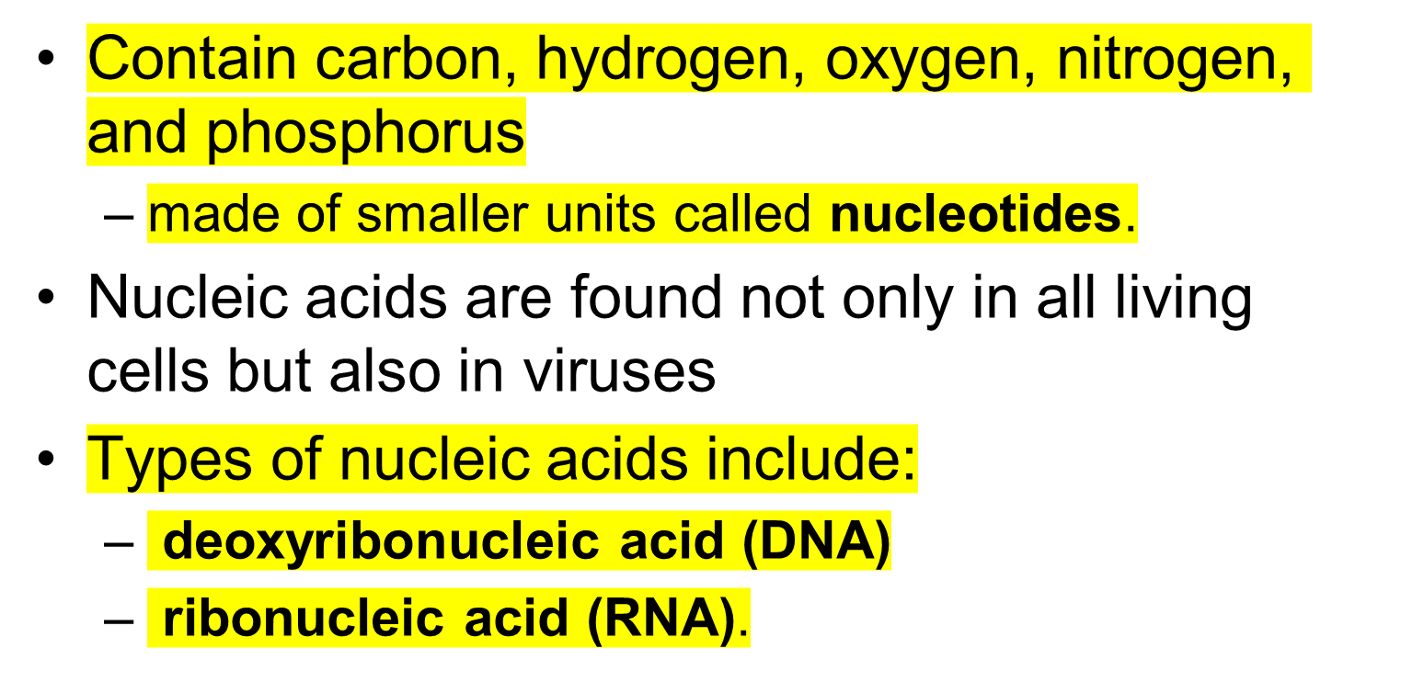
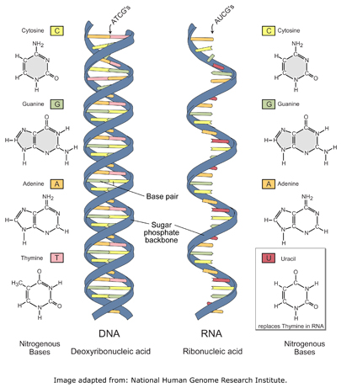

Slide 25
Structure of Nucleic Acids
Consists of one or two chains of nucleotides held together by chemical bonds
Each individual nucleotide unit consists of three parts:
• a base (containing nitrogen)
- four bases: Adenine, Guanine, Cytosine, and
Thymine in DNA, or Uracil in RNA
• a sugar
(deoxyribose in DNA, ribose in RNA)
• a phosphate group (containing phosphorus)
RNA consists of a single chain of nucleotides,
DNA consists of two chains of nucleotides

Slide 26
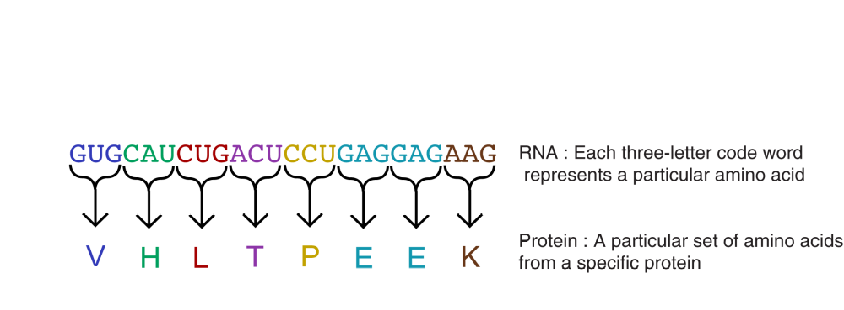
Role of Nucleic Acids
Order of bases in nucleic acids is highly significant
  bases are like the letters of a four-letter alphabet
  ‘‘letters” can be combined to form ‘‘words”
  groups of three bases form words of the genetic code
  each code word stands for a different amino acid
  series of many code words spells out the sequence of amino acids in a protein
Information is passed from a body cell to its daughter cells when the cell divides. It is also passed from parents to their offspring when organisms reproduce.

Slide 27
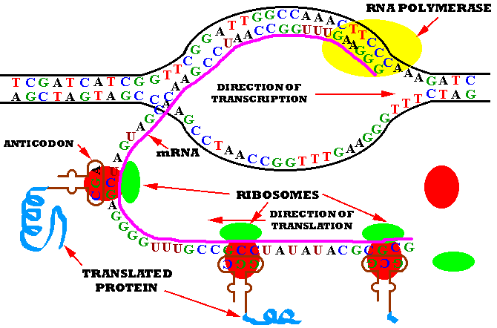
How RNA codes for Proteins
DNA and RNA have different functions relating to the genetic code and proteins
Like a set of blueprints, DNA contains the genetic instructions for the correct sequence of amino acids in proteins
RNA uses the information in DNA to assemble the amino acids and make the proteins.

Slide 28
The Compounds of Life
 | Composition (elements present) | Function | Examples | Monomer
Nucleic acids | Carbon, Hydrogen, Oxygen, Phosphorus, and Nitrogen C,H,O,P,N | Pass on traits Code for amino acids | Deoxyribo-nucleic acid (DNA) Ribonucleic acid (RNA) | Nucleotides

Slide 29
Lesson Summary
Carbon’s exceptional ability to form bonds with other elements and with itself allows it to form
a huge number of large, complex molecules called organic molecules. These molecules make
up organisms and carry out life processes.
Carbohydrates are organic molecules that consist of carbon, hydrogen, and oxygen. They are
made up of repeating units called saccharides. They provide cells with energy, store energy,
and form structural tissues.
Lipids are organic compounds that consist of carbon, hydrogen, and oxygen. They are made
up of fatty acids and other compounds. They provide cells with energy, store energy, and help
form cell membranes.
Proteins are organic compounds that consist of carbon, hydrogen, oxygen, nitrogen, and, in
some cases, sulfur. They are made up of repeating units called amino acids. They provide
cells with energy, form tissues, speed up chemical reactions throughout the body, and perform
many other cellular functions.
Nucleic acids are organic compounds that consist of carbon, hydrogen, oxygen, nitrogen, and
phosphorus. They are made up of repeating units called nucleotides. They contain genetic
instructions for proteins, help synthesize proteins, and pass genetic instructions on to
daughter cells and offspring.

